Slide 1
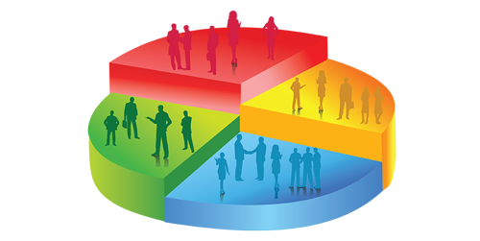
Bank Customer Segmentation Analysis of Customer Demographics & Transaction data Project Brief
Identify distinct groups of customers based on their behavior or other traits. It enables efficient marketing resource allocation, the maximization of point-based approach to each customer group, as well as sales opportunities. It helps in enhancing customer service and retaining customers which are crucial for the banking industry.
Project Goals
The data was collected as a part of research project in collaboration with a bank. The dataset includes Customer demographics and transactions data from an Indian Bank.
This data is an open-source data and downloaded from Kaggle.com.
Data
Python, Anaconda, Jupyter Notebook
Libraries ( Pandas, Numpy, Seaborn, Matplotlib, Scipy, datetime, calendar, folium, sklearn, pylab, statsmodels.api )
Tableau
Source & wrangle Data
Derive Variables & Explore Relationship
Geospatial & Time series Analysis
Linear Regression & Kmeans clustering
Visualization & StoryTelling
Tools used
Data Sourcing, Wrangling & Deriving Variables
Exploratory Visual Analysis
Geospatial Analysis & Time-Series Analysis
Machine Learning –Linear regression & Kmeans Clustering
Visualization & Storytelling
Skills

Slide 2
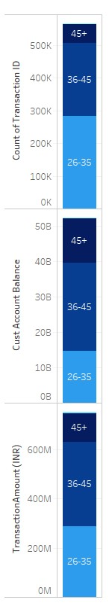
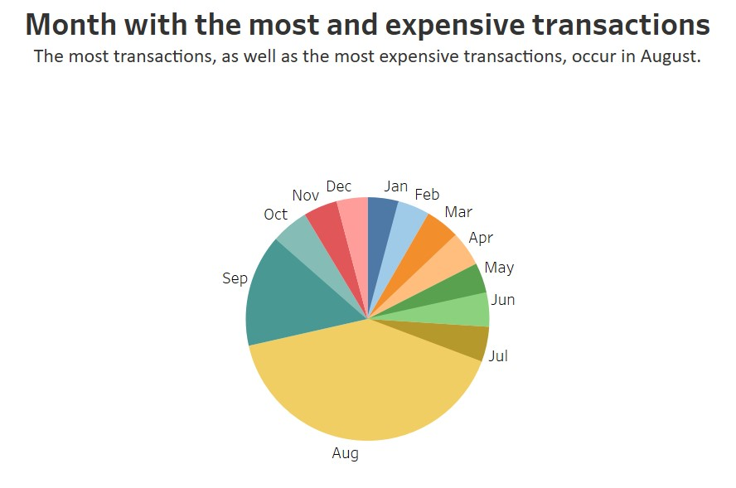
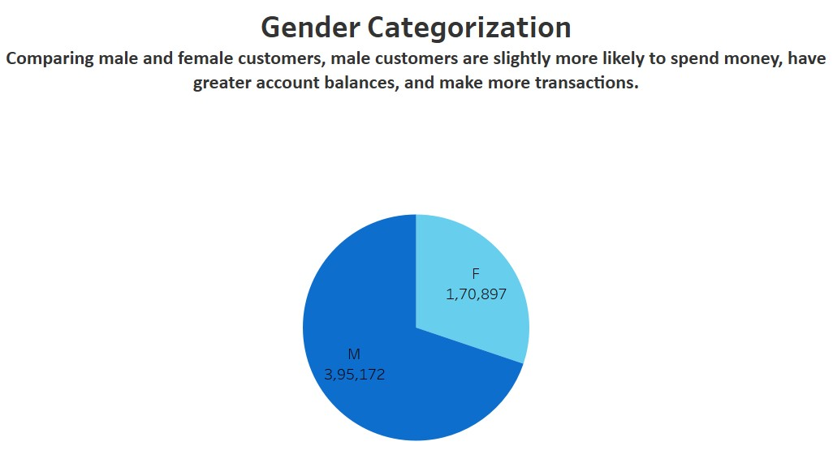
Exploratory Analysis
Age Categorization
Age groups 26 to 35 have more transactions than other age groups, while 36 to 45 have more expensive transactions and higher account balances than other age groups.

Slide 3
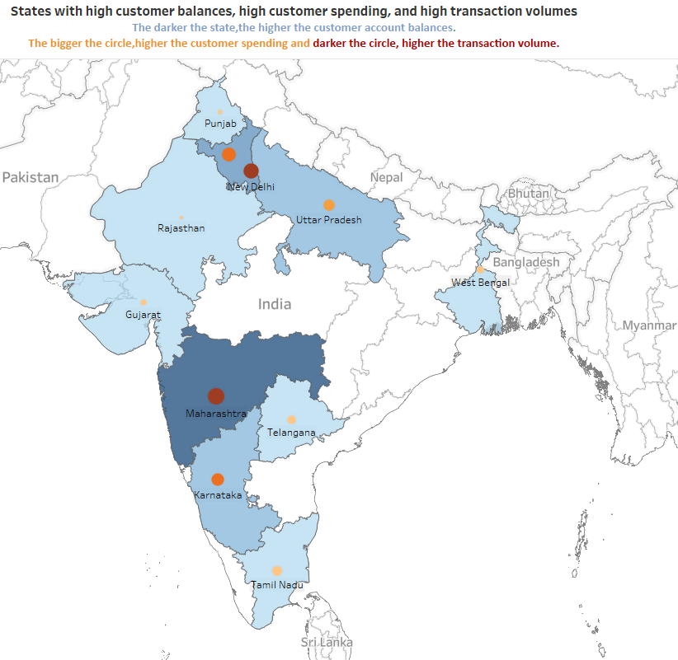
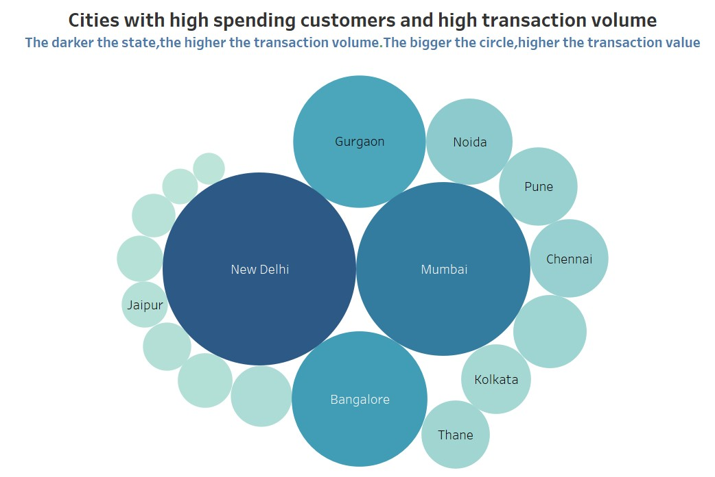
GeoSpatial Analysis

Slide 4
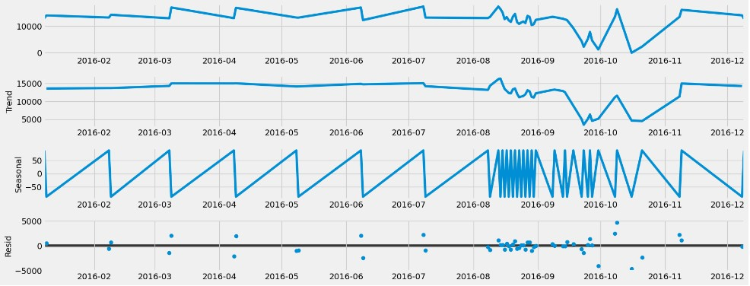
Time Series Analysis
2016 Monthly Transaction Count
The busiest month in 2016 was August, followed by September in terms of transactions.

Slide 5
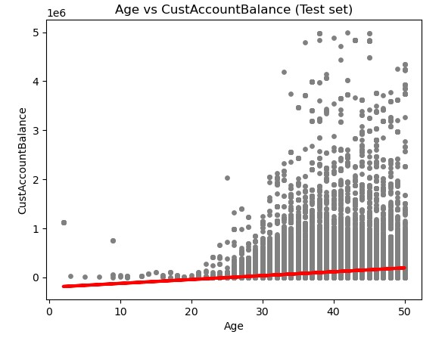
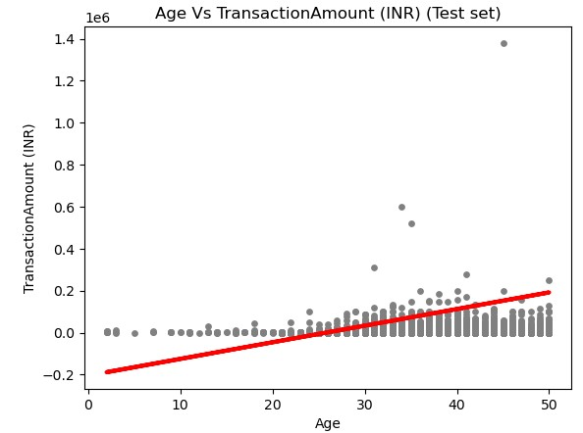
Regression Analysis- Linear Regression
There is no linear relationship between the variables because most of the data points lie outside of the trend line.
The R-squared value is always in the range between 0 and 1, with values closer to 1 denoting a regression model that fits the data more closely. Therefore, the extremely low R-squared value of almost zero and the huge Mean Squared Error demonstrate that the Linear regression is not the best model for the dataset.
Even though the positive slope value indicates a solid association between the variables in this case, the MSE & R2 score value prevents us from utilizing this model to generate predictions.

Slide 6
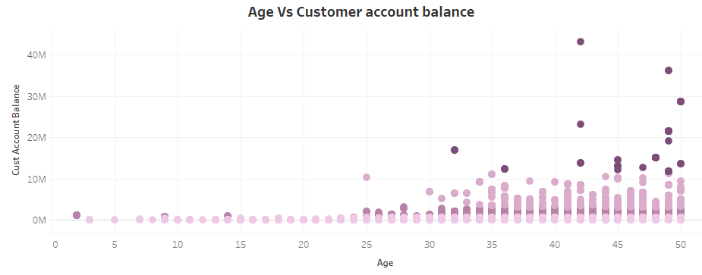
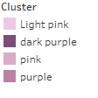
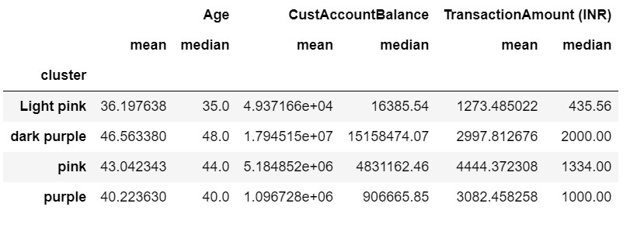
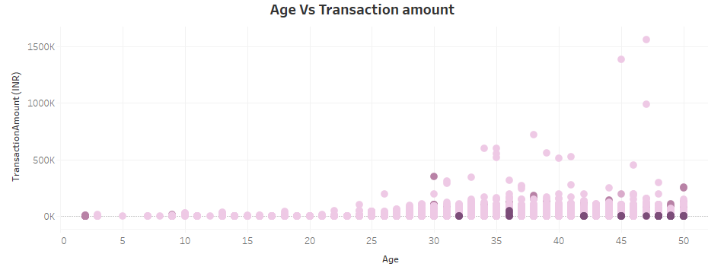
Clustering Analysis – Kmeans Clustering
Since Linear regression model didn't seem to fit well to the data, the analysis moved on to machine learning using k-means clustering. The optimal number of clusters has been identified to be four using the Elbow technique. After that, a model was created using kmeans clustering and the resulting clusters produced insightful results.
Cluster Analysis Results
In terms of statistics across all categories, the dark purple cluster outperforms pink, purple, and light pink.
In comparison to other groups, the dark purple cluster's customers are older, have larger account balances, and do more transactions.
As a result, it is evident that a customer's account balance and transactional or spending amounts increase with age.

Slide 7
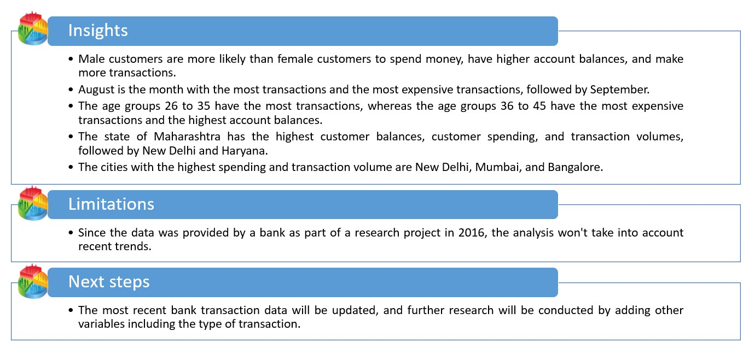


Insights from Data
The statistics supported my hypothesis, "Customers' account balances and transactional or spending quantities increase as they get older."
Click below to view detailed Report, Scripts & Visualizations

Slide 8
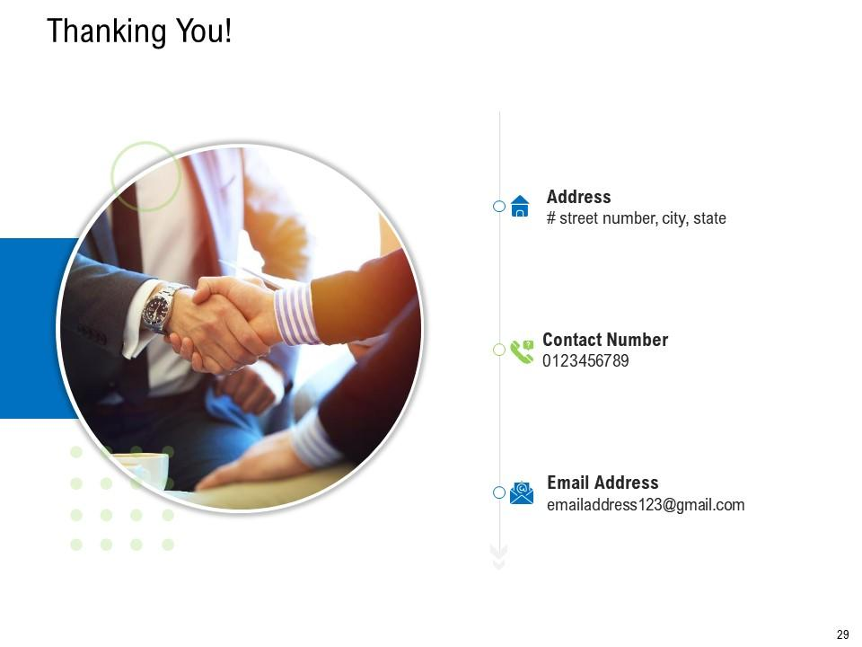

Let's connect and explore how I can help you achieve your business objectives
sruthysreekanth@gmail.com
https://www.linkedin.com/in/sruthy-sreekanth/
https://github.com/sruthysreekanth
https://public.tableau.com/app/profile/sruthy.sreekanth

